Slide 1
EKGs and Cardiac Management
Eli Rogers, Crew Chief Trainee
RC MERT Inservice
August 25, 2015

Slide 2
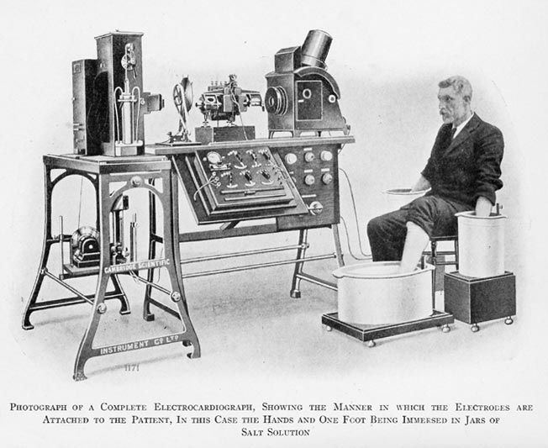
EKG? ECG? Electrocardiogram?
1901
Voltage to map rhythms
EMT-A and above
Highly sensitive
https://commons.wikimedia.org/wiki/File:Willem_Einthoven_ECG.jpg

Slide 3
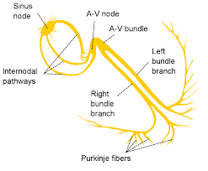
Heart Conduction
SA Node is pacemaker
AV Node slows transmission
Purkinje fibers spread depolarization
SA → AV→ L/R BB→ Purkinje
Atria → Pause → Ventricles
https://upload.wikimedia.org/wikipedia/commons/e/e7/Electrical_conduction_system_of_the_heart.svg

Slide 4
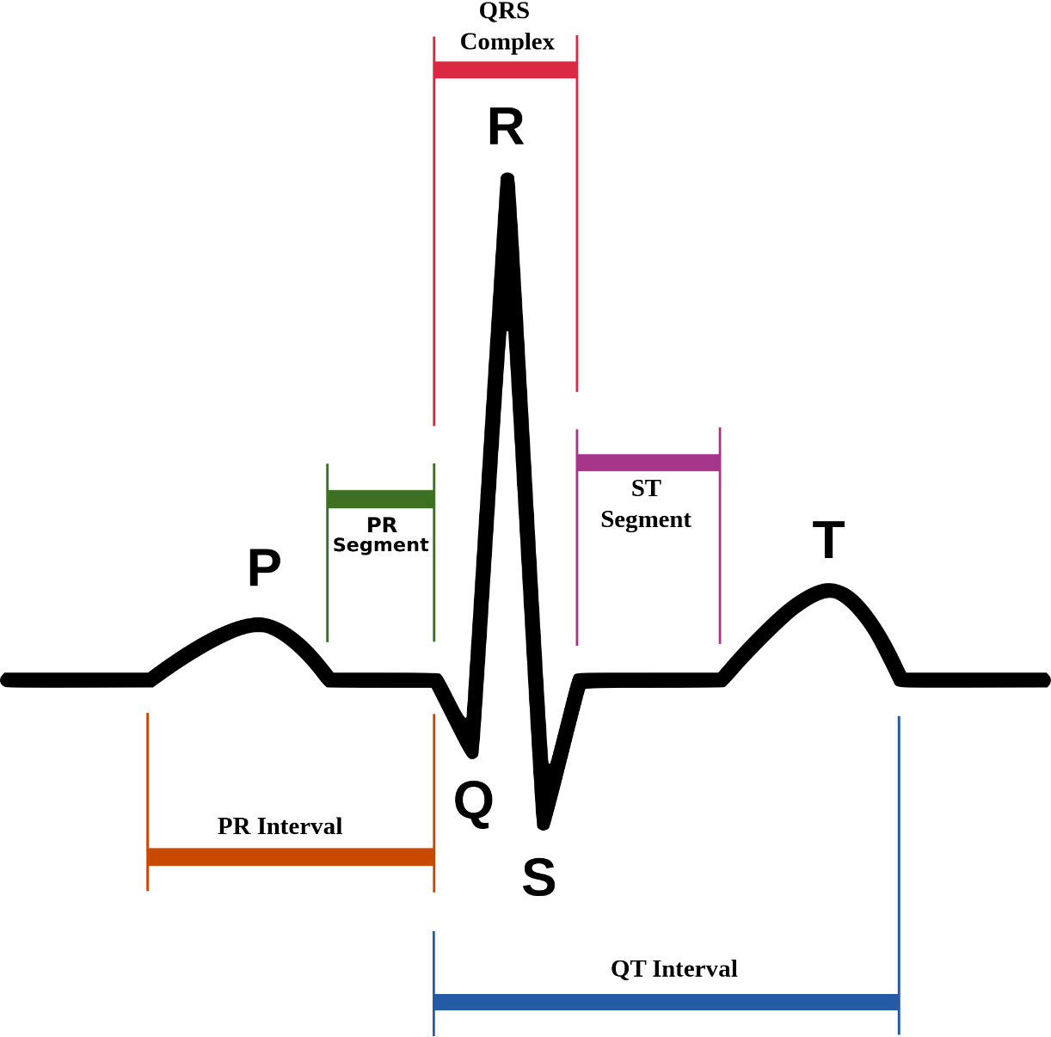
EKG Reading
P wave = SA depolarization = Atrial contraction
PQ interval = AV Node / Pause
QRS complex = Bundle Branches / Purkinje fibers depolarization = ventricular contraction
T wave = Ventricular repolarization
http://www.todayifoundout.com/wp-content/uploads/2011/10/ekg.png

Slide 5
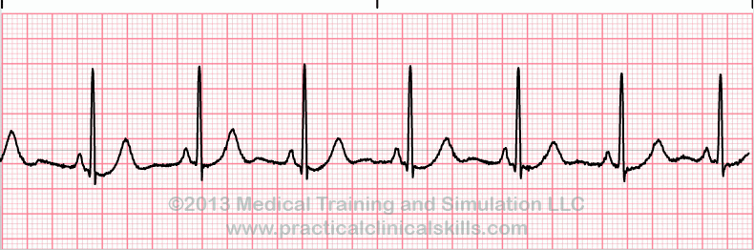
What It Really Looks Like
Rhythm / Rate / P-wave / PR / QRS / T-wave / QT / ST
Physiology
http://d2ik8svv2swg1p.cloudfront.net/ekgtracings/70.gif

Slide 6
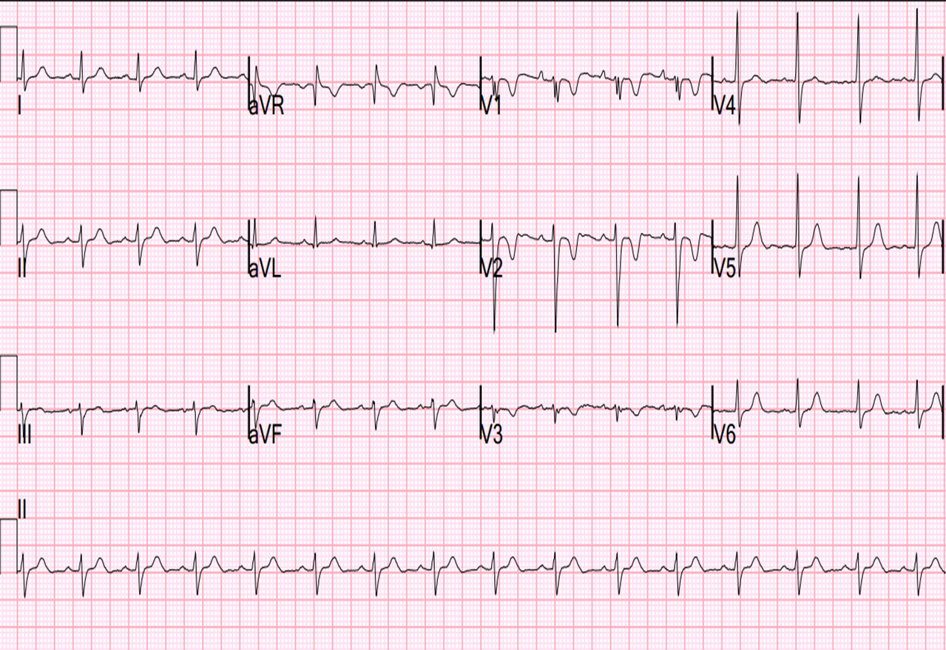
What It REALLY Looks Like
http://www.pedcard.rush.edu/mp/ECG/ECGweb/Normal-Master.jpg

Slide 7
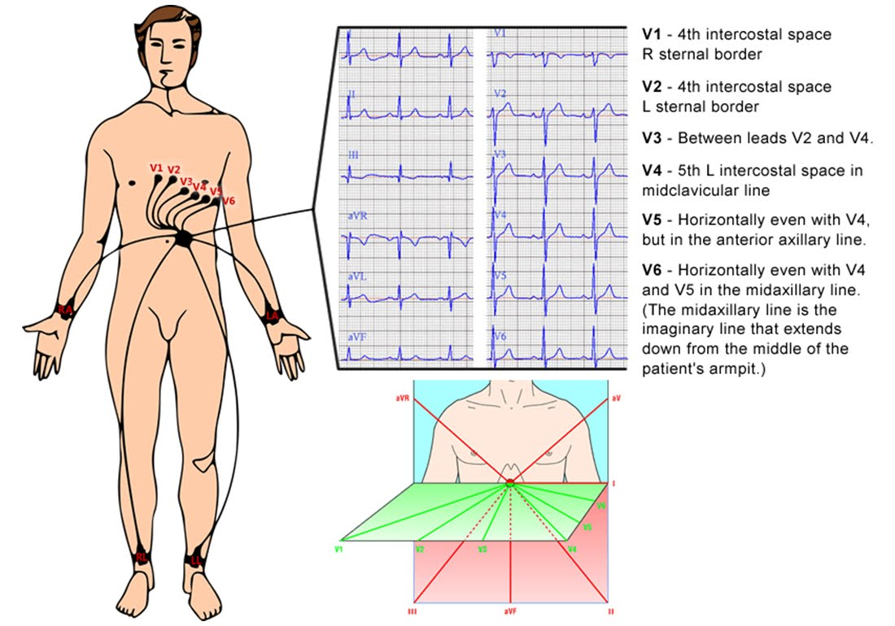
12-Lead EKG
Shows direction of depolarization
Shows size, shape of heart
Localizes issues
http://2.bp.blogspot.com/_5Nslwo9F6bI/S_ETxuu0y-I/AAAAAAAAAgg/El025edV69s/s1600/Ecg+electrode+placement.jpg

Slide 8
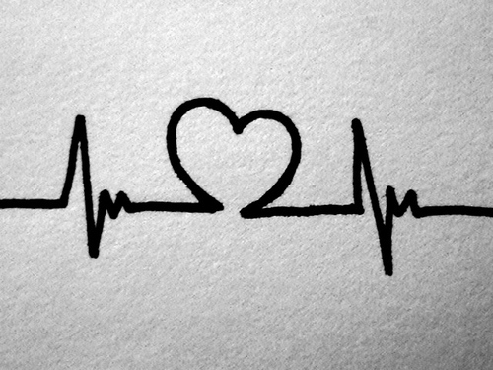
Arrhythmias

Slide 9
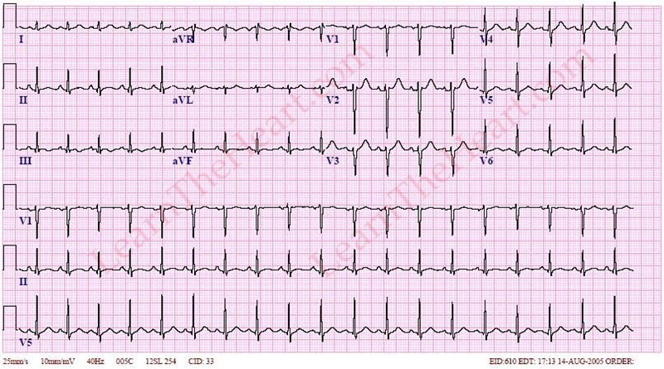
Tachycardia

Slide 10
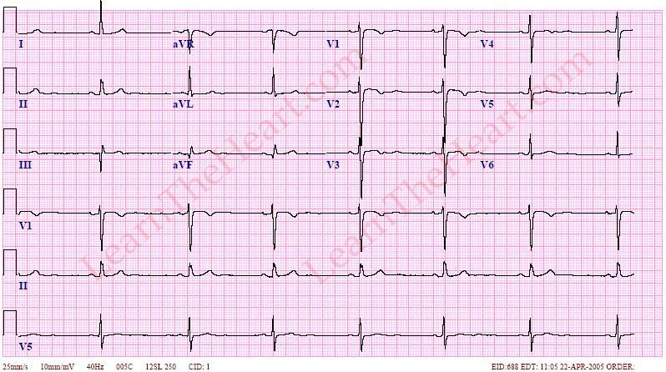
Bradycardia

Slide 11
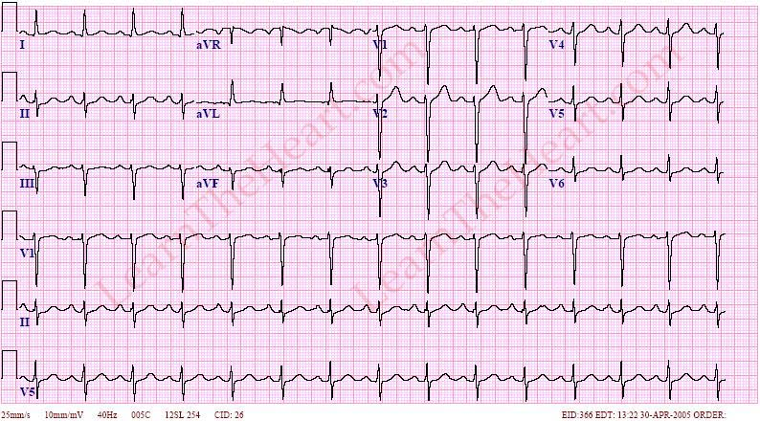
First Degree Heart Block

Slide 12
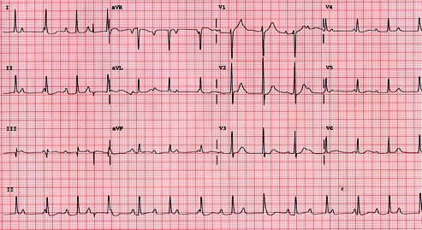
Second Degree Heart Block (Type I)

Slide 13
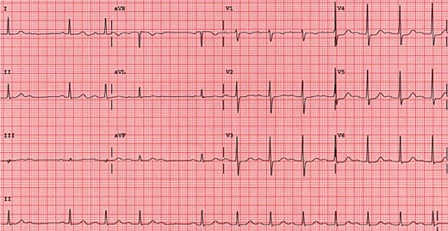
Second Degree Heart Block (Type II)

Slide 14
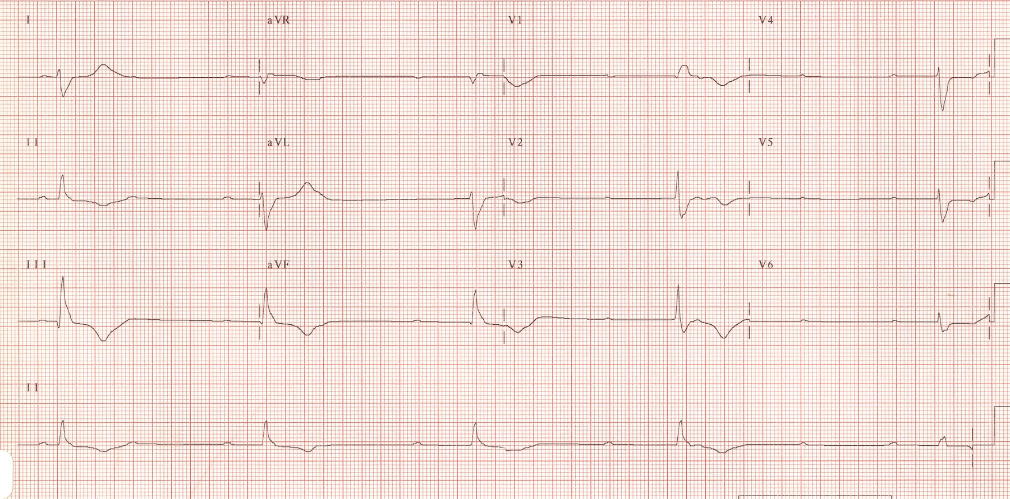
Third Degree (Complete) Heart Block
http://cdn.lifeinthefastlane.com/wp-content/uploads/2011/08/CHB2.jpg

Slide 15
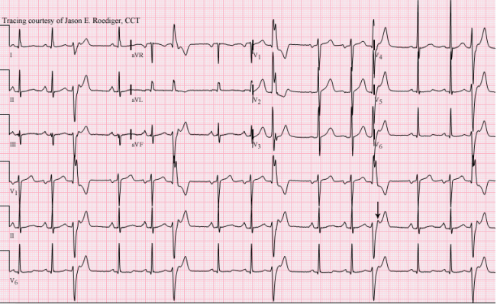
Premature Ventricular Complex
http://ecgguru.com/sites/default/files/styles/scale_650px_width/public/ECG%20of%20the%20Week%202i-b%20ladder.png?itok=zS3P8j8k

Slide 16
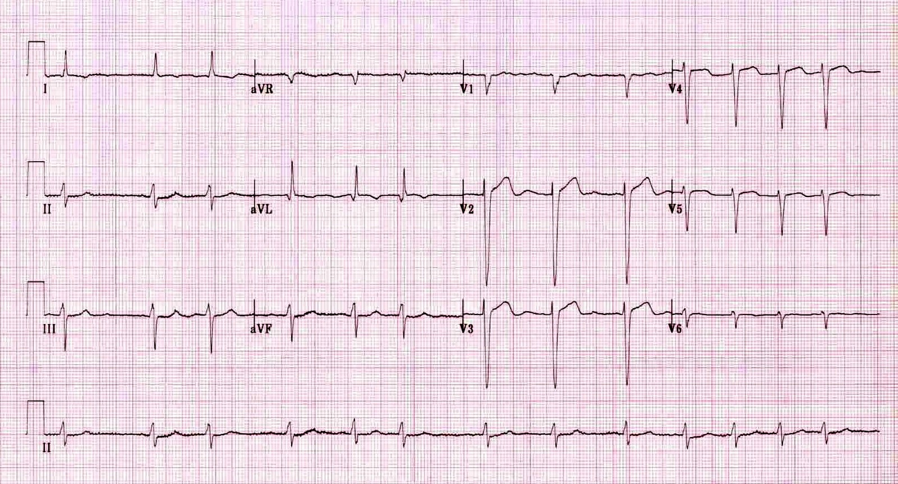
Atrial Fibrillation
http://cdn.lifeinthefastlane.com/wp-content/uploads/2012/01/af3.jpg

Slide 17
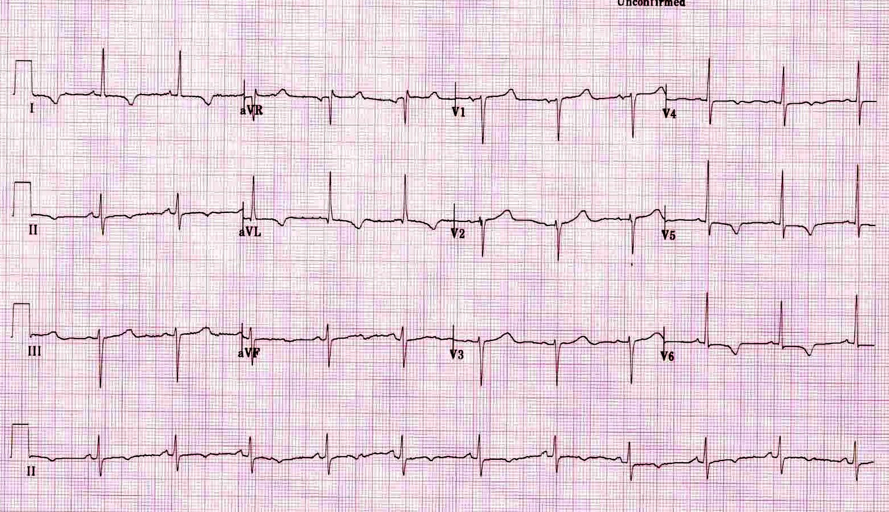
Myocardial Infarction
http://cdn.lifeinthefastlane.com/wp-content/uploads/2012/01/Lateral-TWI.jpg

Slide 18
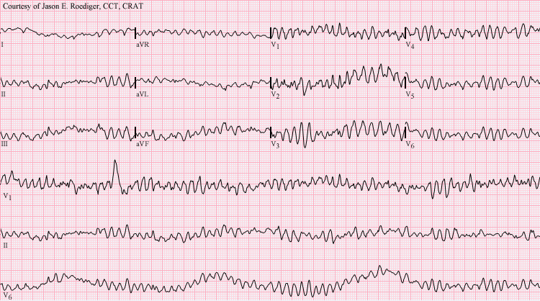
Ventricular Fibrillation
SHOCK!!!!
https://upload.wikimedia.org/wikipedia/commons/f/f1/Ventricular_fibrillation.png

Slide 19
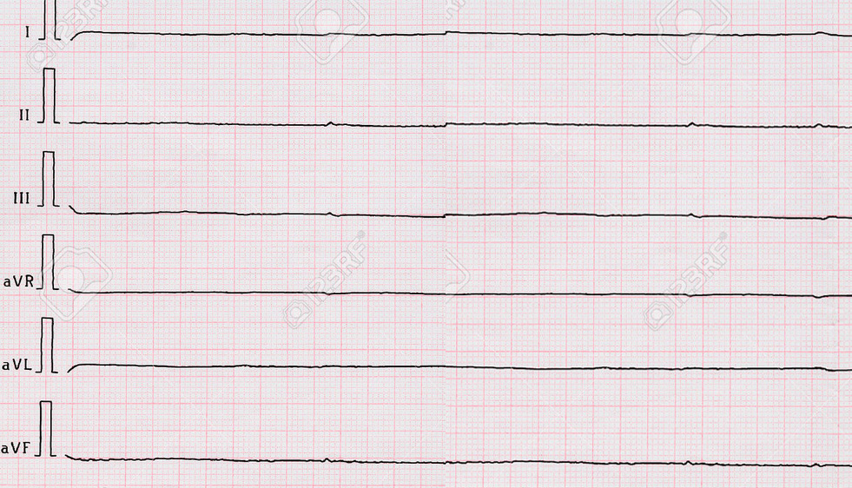
Asystole

Slide 20
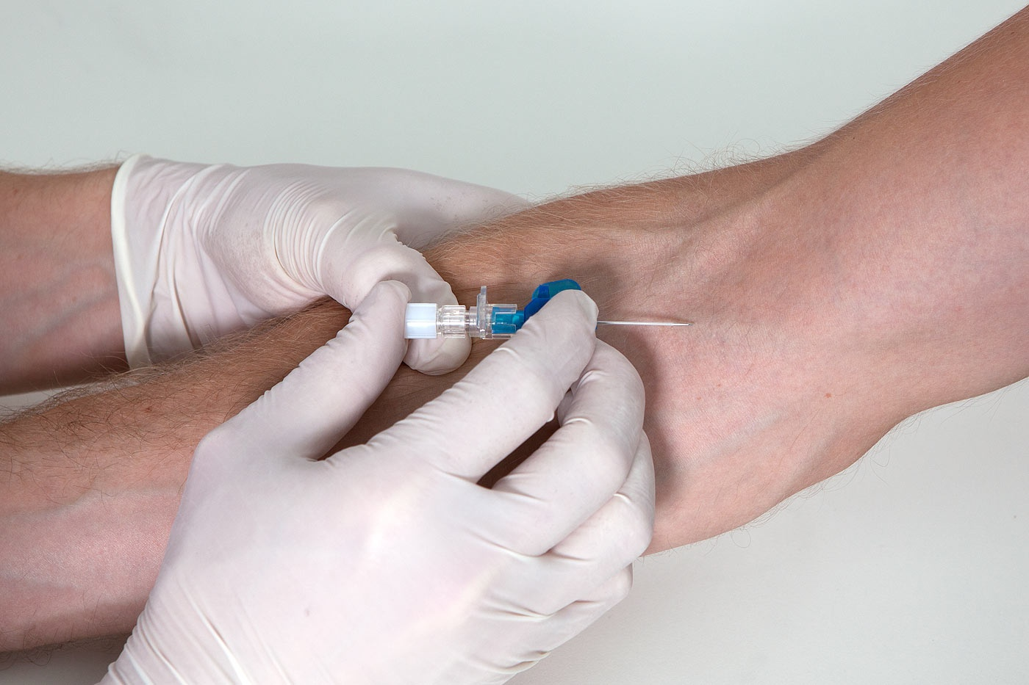
ALS Management
- Intubation
EKG
- Vascular Access (IV Line)
Medication (epinephrine / vasopressin, amiodarone / lidocaine / magnesium sulfate, atropine / dopamine, saline, etc.)
http://www.osceskills.com/resources/Insert-the-needle-bevel-upwards-at-about-30-degrees.jpg

Slide 21

BLS Management
CPR / AED if pulseless
Presence of chest pain
Trauma determination
Hx of heart problems
Risk factors
Onset, signs, symptoms
Aspirin or
Nitroglycerin
Oxygen if necessary
Deterioration / procession
Transport
(324mg)
(.4mg)
http://www.albanyivf.com/wp-content/uploads/sites/25/2014/01/pills.jpg

Slide 22

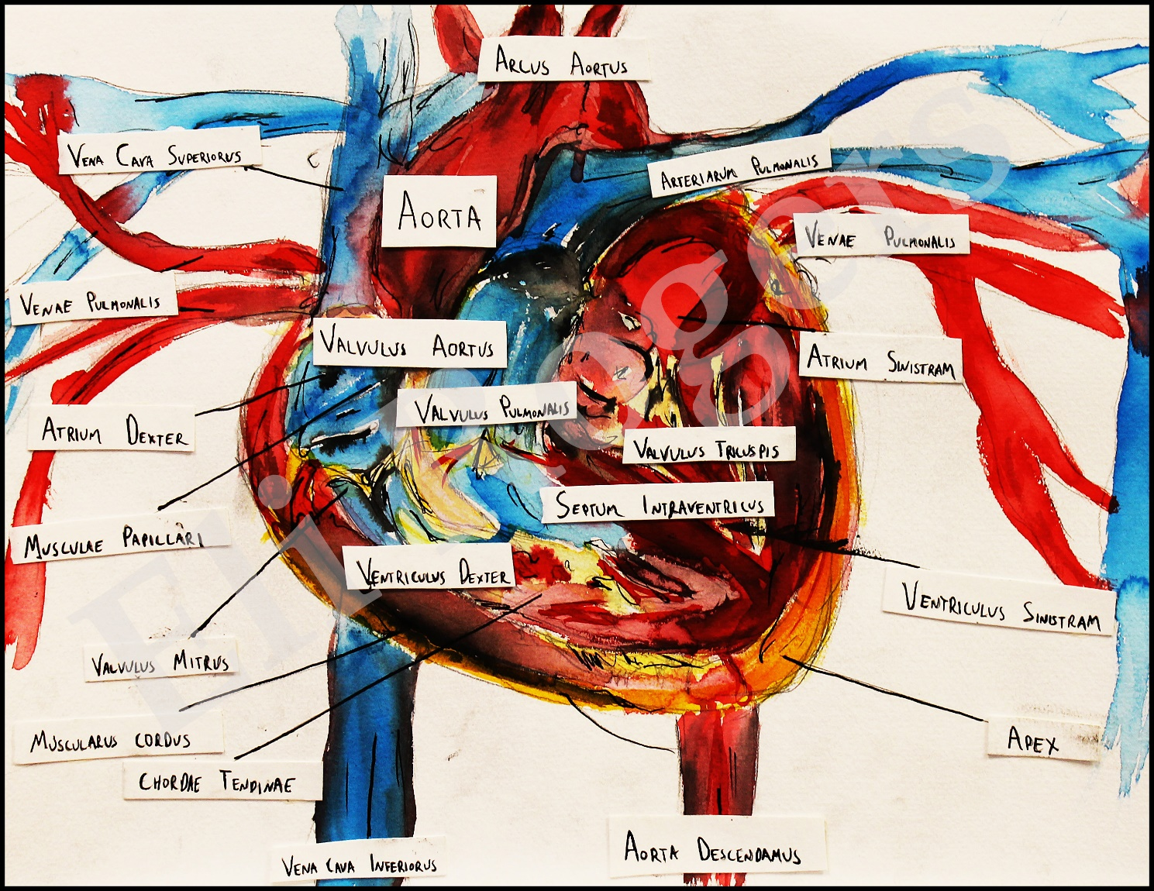
Scenarios!
Taz Mueller; Lafayette, Colorado
Eli Rogers; Rochester, New York

